Slide 1

Chapter 6
Bandwidth Utilization: Multiplexing and Spreading

Slide 2

Bandwidth Utilization
Note
Bandwidth utilization is the wise use of
available bandwidth to achieve
specific goals.
Efficiency can be achieved by multiplexing; privacy and anti-jamming can be achieved by spreading.

Slide 3
6.1 MULTIPLEXING
Whenever the bandwidth of a medium linking two devices is greater than the bandwidth needs of the devices, the link can be shared. Multiplexing is the set of techniques that allows the simultaneous transmission of multiple signals across a single data link. As data and telecommunications use increases, so does traffic.
Topics discussed in this section:
Frequency-Division Multiplexing
Wavelength-Division Multiplexing
Synchronous Time-Division Multiplexing
Statistical Time-Division Multiplexing

Slide 4

Multiplexing
Dividing a link into channels
Word link refers to the physical path
Channel refers to the portion of a link that carries a transmission
between a given pair of lines.

Slide 5


Multiplexing
Multiplexing
  is the set of techniques that allows the simultaneous transmission of multiple signals across a single data link.

Slide 6
FDM
Multiplexer
  transmission streams combine into a single stream(many to one)
Demultiplexer
  stream separates into its component transmission(one to many) and directs them to their intended receiving devices

Slide 7
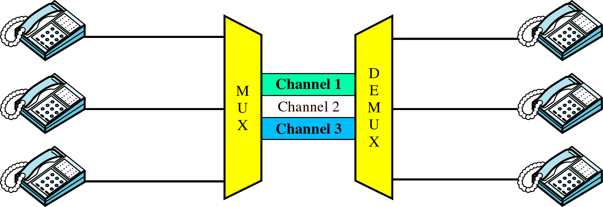
FDM
FDM (Frequency-Division)
FDM is an analog multiplexing technique that combines analog signals.

Slide 8
FDM (cont’d)
FDM process
  each telephone generates a signal of a similar frequency range
  these signals are modulated onto different carrier frequencies(f1, f2, f3)

Slide 9
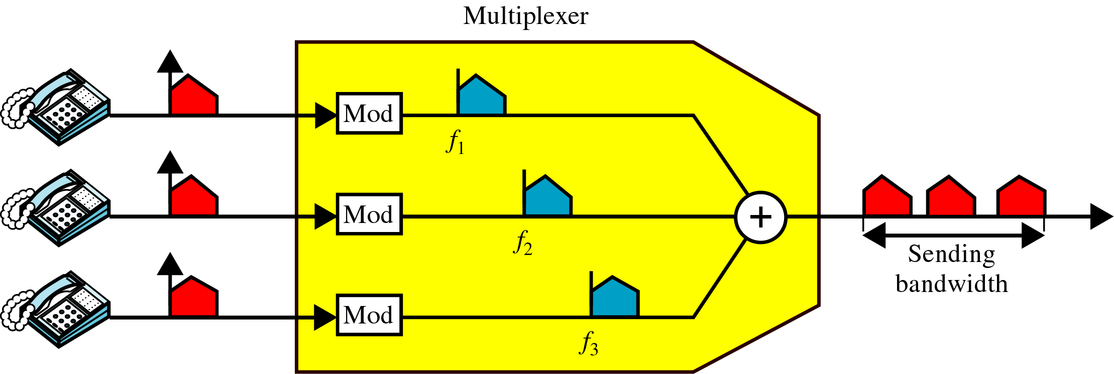
FDM(cont’d)
FDM multiplexing process, frequency-domain
0
4
20 24
00
0
4
24 28
20 32
0
4
28 32

Slide 10
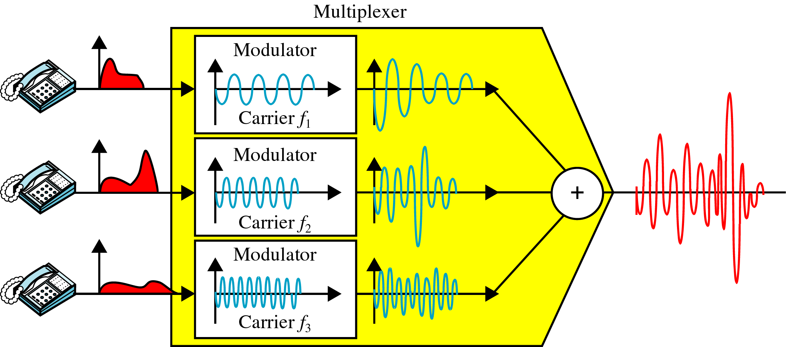
FDM (cont’d)
FDM multiplexing process, time-domain

Slide 11
FDM(cont’d)
Demultiplexing
  separates the individual signals from their carries and passes them to the waiting receivers.

Slide 12
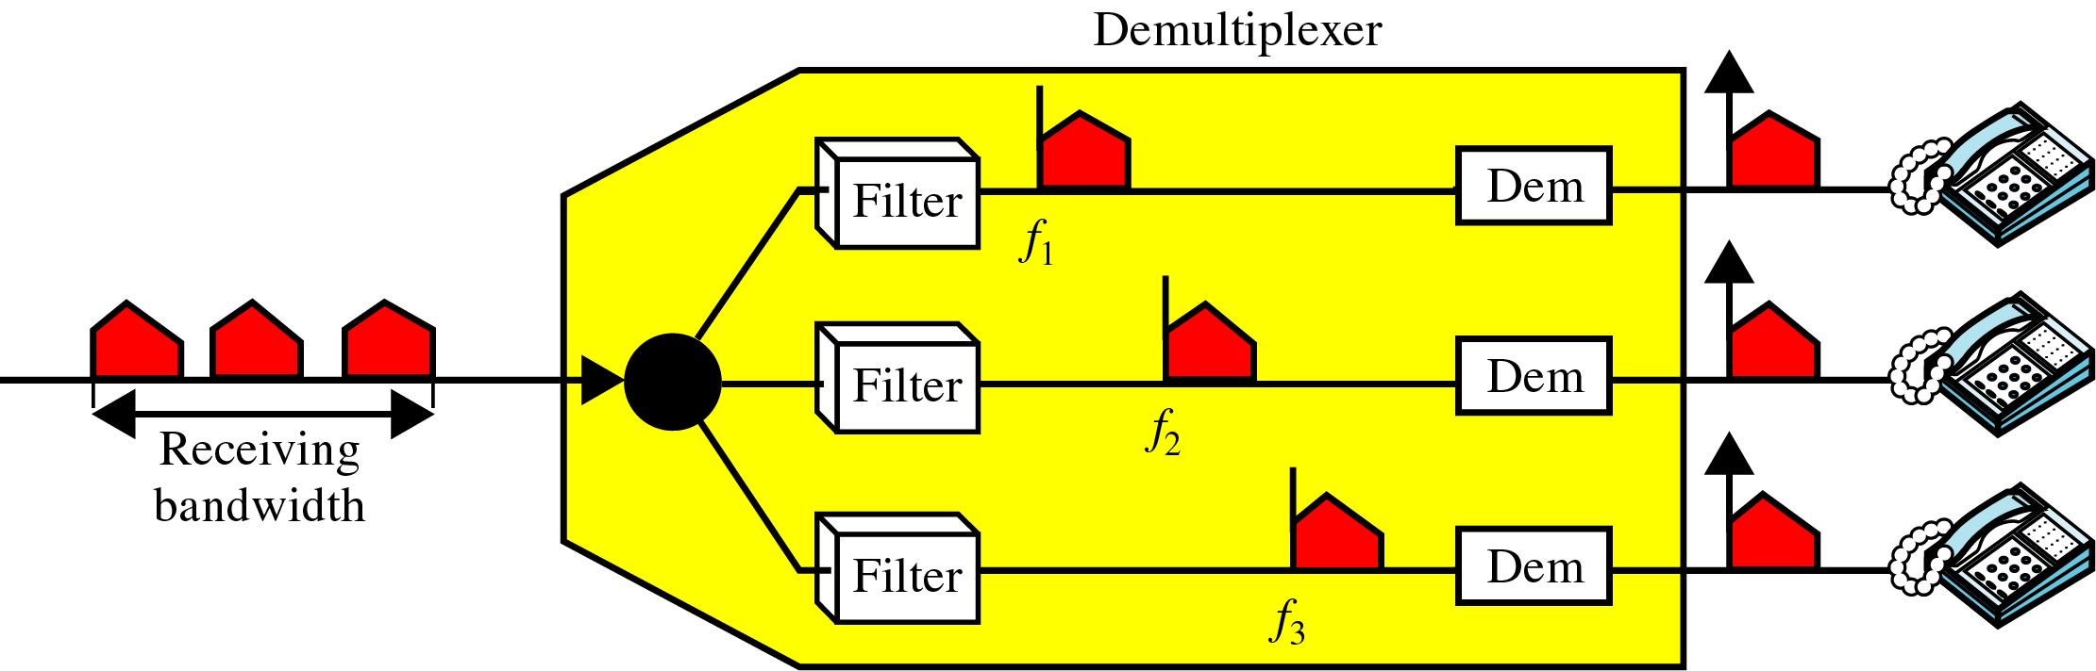
FDM(cont’d)
FDM demultiplexing, frequency-domain
20
20 24
0
4
24
24 28
0
4
20 32
28
28 32
0
4

Slide 13
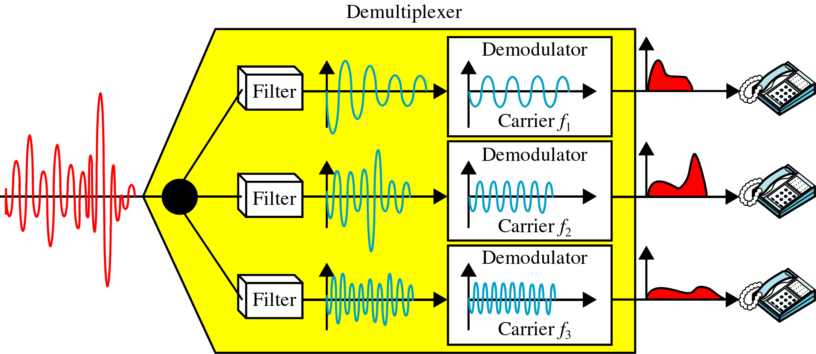
FDM(cont’d)
FDM demultiplexing process, time-domain

Slide 14
Example 6.1
Assume that a voice channel occupies a bandwidth of 4 kHz. We need to combine three voice channels into a link with a bandwidth of 12 kHz, from 20 to 32 kHz. Show the configuration, using the frequency domain. Assume there are no guard bands.
Solution
We shift (modulate) each of the three voice channels to a different bandwidth, as shown in Figure 6.6. We use the 20- to 24-kHz bandwidth for the first channel, the 24- to 28-kHz bandwidth for the second channel, and the 28- to 32-kHz bandwidth for the third one. Then we combine them as shown in Figure 6.6.

Slide 15

FDM(cont’d)
Figure 6.6 Example 6.1

Slide 16
Example 6.2
Five channels, each with a 100-kHz bandwidth, are to be multiplexed together. What is the minimum bandwidth of the link if there is a need for a guard band of 10 kHz between the channels to prevent interference?
Solution
For five channels, we need at least four guard bands. This means that the required bandwidth is at least
5 × 100 + 4 × 10 = 540 kHz,
as shown in Figure 6.7.

Slide 17

FDM(cont’d)
Figure 6.7 Example 6.2

Slide 18
Example 6.3
Four data channels (digital), each transmitting at 1 Mbps, use a satellite channel of 1 MHz. Design an appropriate configuration, using FDM.
Solution
The satellite channel is analog. We divide it into four channels, each channel having a 250-kHz bandwidth. Each digital channel of 1 Mbps is modulated such that each 4 bits is modulated to 1 Hz. One solution is 16-QAM modulation. Figure 6.8 shows one possible configuration.

Slide 19
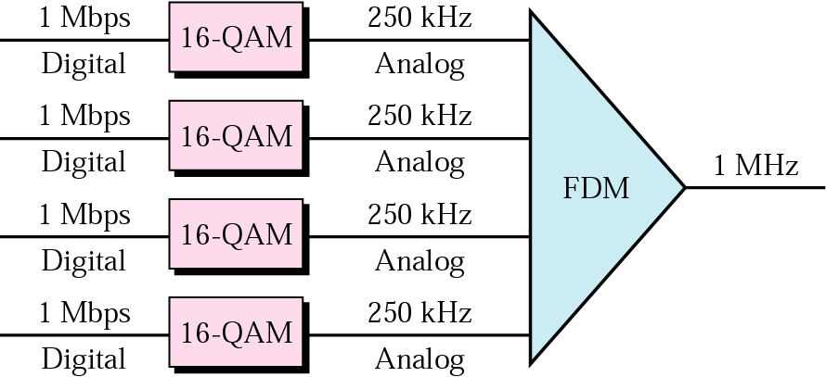
Figure 6.8 Example 6.3
FDM(cont’d)

Slide 20
FDM(cont’d)
Example : Cable Television
  coaxial cable has a bandwidth of approximately 500Mhz
  individual television channel requires about 6Mhz of bandwidth for transmission
  can carry 83 channels theoretically

Slide 21
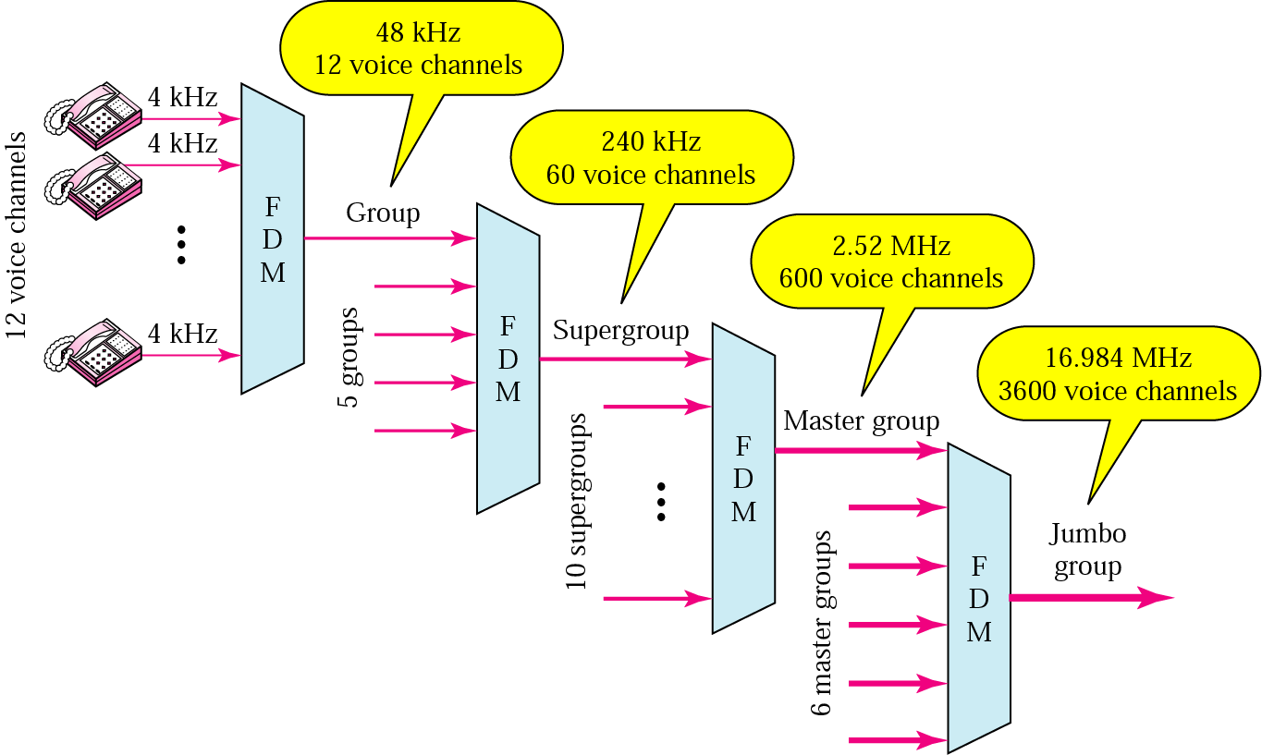
Analog Hierarchy
To maximize the efficiency of their infrastructure, telephone companies have traditionally
multiplexed signals from lower bandwidth lines onto higher bandwidth lines.

Slide 22
Example 6.4
The Advanced Mobile Phone System (AMPS) uses two bands. The first band of 824 to 849 MHz is used for sending, and 869 to 894 MHz is used for receiving. Each user has a bandwidth of 30 kHz in each direction. How many people can use their cellular phones simultaneously?
Solution
Each band is 25 MHz. If we divide 25 MHz by 30 kHz, we get 833.33. In reality, the band is divided into 832 channels. Of these, 42 channels are used for control, which means only 790 channels are available for cellular phone users.

Slide 23
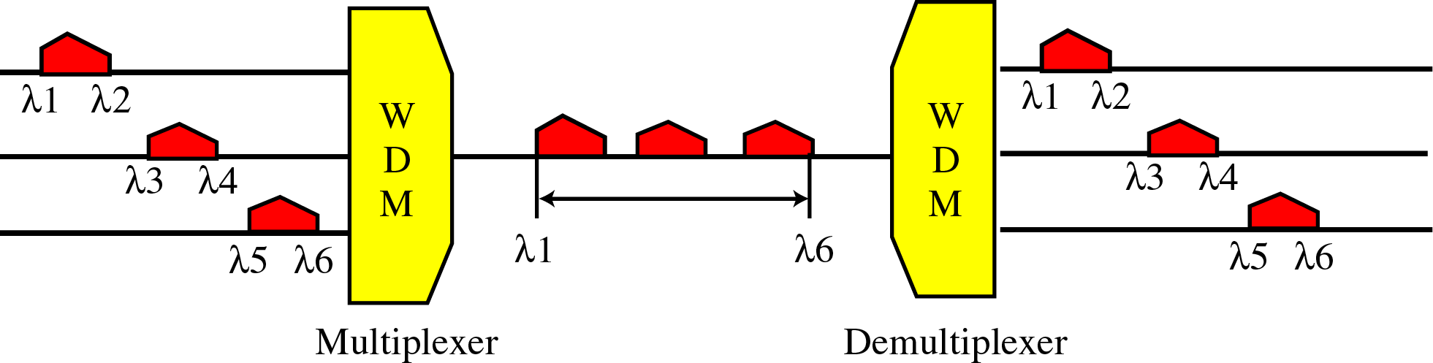
Wavelength Division Multiplexing (WDM)
WDM is conceptually same as FDM
  except that the multiplexing and demultiplexing involve light signals transmitted through fiber-optic channels

Slide 24
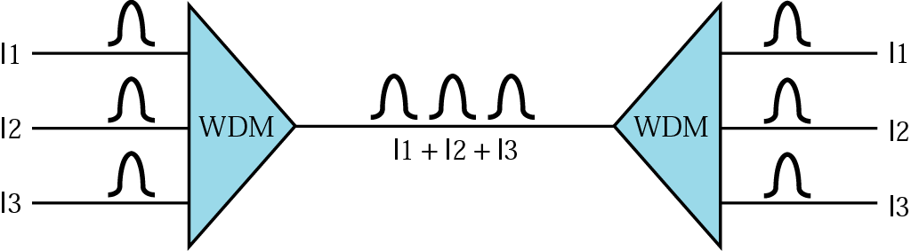
WDM (cont’d)
WDM is an analog multiplexing technique to combine optical signals.
λ1
λ1
λ2
λ2
λ1
+
λ2
+
λ3
λ3
λ3
Very narrow bands of light from different sources are combined to make
a wider band of light

Slide 25

WDM (cont’d)
Combining and splitting of light sources are easily handled by a prism
  Prism bends a beam of light based on the angle of incidence and the frequency.
  One application is the SONET.

Slide 26
TDM
TDM(Time-Division Multiplexing)
  is a digital process that can be applied when the data rate capacity of the transmission medium is greater than the data rate required by the sending and receiving device
DM is a digital multiplexing technique for combining several low-rate
channels into one high-rate one.

Slide 27
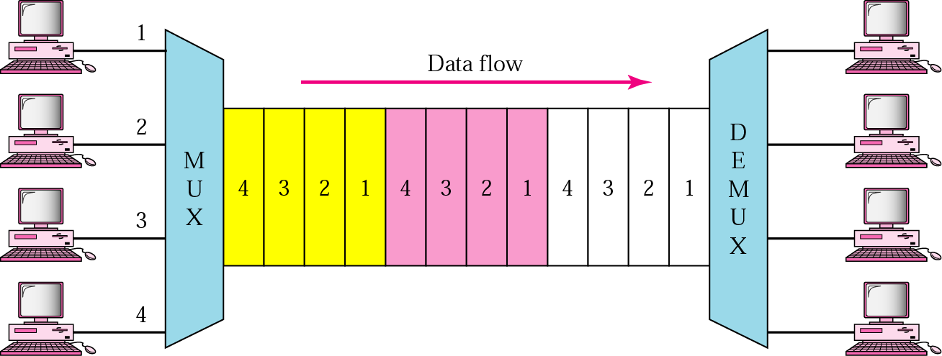
TDM(cont’d)
Time-Division Multiplexing
  is a digital process that allows several connections to share the high bandwidth of a link, time is shared.
  Two different schemes : Synchronous TDM & Statistical TDM

Slide 28

TDM(cont’d)
Figure 6.13 Synchronous time-division multiplexing
UNIT
UNIT
Time slot(T/3 sec)
In Synchronous TDM, the data rate of the link is n times
faster, and the unit duration is n times shorter.

Slide 29
Example 6.5
In Figure 6.13, the data rate for each input connection is 1 kbps. If 1 bit at a time is multiplexed (a unit is 1 bit), what is the duration of (a) each input slot, (b) each output slot, and (c) each frame?
Solution
We can answer the questions as follows:
a. The data rate of each input connection is 1 kbps. This means that the bit duration is 1/1000 s or 1 ms. The duration of the input time slot is 1 ms (same as bit duration).

Slide 30
Example 6.5 (continued)
b. The duration of each output time slot is one-third of the input time slot. This means that the duration of the output time slot is 1/3 ms.
c. Each frame carries three output time slots. So the duration of a frame is 3 × 1/3 ms, or 1 ms. The duration of a frame is the same as the duration of an input unit.

Slide 31
Example 6.6
Figure 6.14 shows synchronous TDM with a data stream for each input and one data stream for the output. The unit of data is 1 bit. Find (a) the input bit duration, (b) the output bit duration, (c) the output bit rate, and (d) the output frame rate.
Solution
We can answer the questions as follows:
a. The input bit duration is the inverse of the bit rate:
1/1 Mbps = 1 μs.
b. The output bit duration is one-fourth of the input bit duration, or ¼ μs.

Slide 32
Example 6.6 (continued)
c. The output bit rate is the inverse of the output bit duration or 1/(1/4μs) or 4 Mbps. This can also be deduced from the fact that the output rate is 4 times as fast as any input rate; so the output rate = 4 × 1 Mbps = 4 Mbps.
d. The frame rate is always the same as any input rate. So the frame rate is 1,000,000 frames per second. Because we are sending 4 bits in each frame, we can verify the result of the previous question by multiplying the frame rate by the number of bits per frame.

Slide 33

TDM(cont’d)
Figure 6.14 Synchronous TDM Example 6.6

Slide 34
Example 6.7
Four 1-kbps connections are multiplexed together. A unit is 1 bit. Find (a) the duration of 1 bit before multiplexing, (b) the transmission rate of the link, (c) the duration of a time slot, and (d) the duration of a frame.
Solution
We can answer the questions as follows:
a. The duration of 1 bit before multiplexing is 1 / 1 kbps, or 0.001 s (1 ms).
b. The rate of the link is 4 times the rate of a connection, or 4 kbps.

Slide 35
Example 6.7 (continued)
c. The duration of each time slot is one-fourth of the duration of each bit before multiplexing, or 1/4 ms or 250 μs. Note that we can also calculate this from the data rate of the link, 4 kbps. The bit duration is the inverse of the data rate, or 1/4 kbps or 250 μs.
d. The duration of a frame is always the same as the duration of a unit before multiplexing, or 1 ms. We can also calculate this in another way. Each frame in this case has four time slots. So the duration of a frame is 4 times 250 μs, or 1 ms.

Slide 36

Synchronous TDM (cont’d)
Interleaving
  Synchronous TDM can be compared to a very fast rotating switch
  Switches are synchronized and rotate at the same speed, but in opposite directions.
  On the multiplexing side, as the switch opens in front of a connection, that connection has the opportunity to send a unit onto the path.
  This process is called INTERLEAVING.
  On the demultiplexing side, as the switch opens in front of a connection, that has the opportunity to receive a unit from the path.

Slide 37
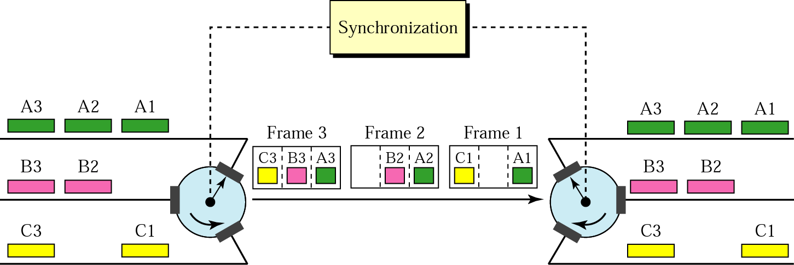
Synchronous TDM (cont’d)
Empty Slots
  If a source does not have data to send, the corresponding slot in the output frame is empty.

Slide 38
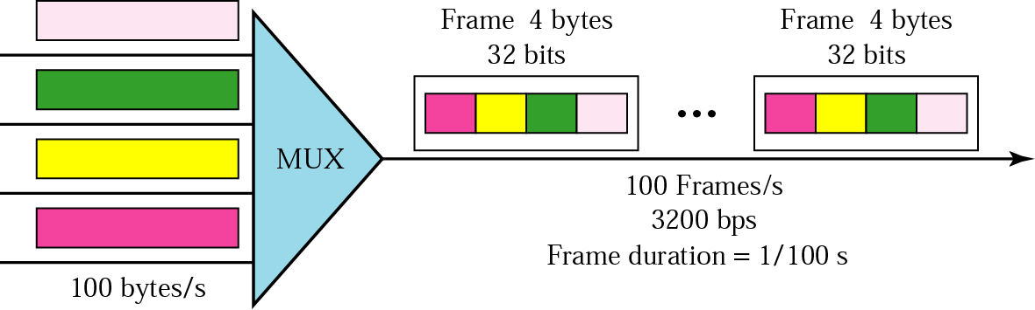
Synchronous TDM (cont’d)
Example 6.8
Four channels are multiplexed using TDM. If each channel sends 100 bytes/s and we multiplex 1 byte per channel, show the frame traveling on the link, the size of the frame, the duration of a frame, the frame rate, and the bit rate for the link.
Solution
Frame size : 1byteX4line=
Frame rate :
Bit rate of the link =100FramesX32bit=

Slide 39
Synchronous TDM (cont’d)
Example 6.9
A multiplexer combines four 100-Kbps channels using a time slot of 2 bits. Show the output with four arbitrary inputs. What is the frame rate? What is the frame duration? What is the bit rate? What is the bit duration?

Slide 40
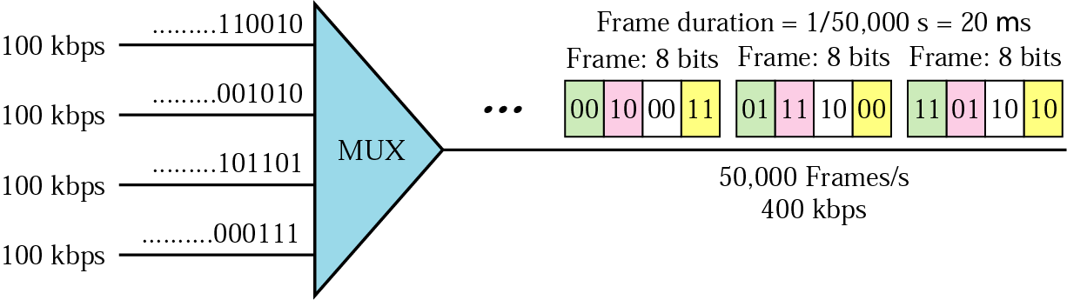
Synchronous TDM (cont’d)
Solution
Figure 6.17 shows the output for four arbitrary inputs.
20 usec
Frame rate : 100Kbps, 2bits/channel, 100,000b/2=50,000 frame/sec
Frame duration : 1/50,000sec = 2X10⁻⁵sec = 20 usec
Bit rate : bits/frame, 50,000 frames x 8 bits = 400 kbps
Bit duration : 1/400,000sec = 2.5μsec

Slide 41
Synchronous TDM - Data rate Management
How to handle a disparity in the data rates with TDM.
  If data rates are not the same, 3 strategies can be used.
    Multi-level multiplexing
    Multiple-Slot Allocation
    Pulse Stuffing

Slide 42

Synchronous TDM - Multilevel multiplexing
Multilevel multiplexing is a technique used when the data rate of an input line is a multiple of others.
  For example, the first two 20khz input lines can be multiplexed together to provide a data rate equal to the last three.
  A second level of multiplexing can create an output of 160 kbps.

Slide 43

Synchronous TDM - Multiple-Slot Allocation
Sometime it is more efficient to allot more than one slot in a frame to a single input line.
  For example, the input line with a 50-kbps data rate can be given two slots in the output.
  We insert a serial-to-parallel converter in the line to make two inputs out of one.

Slide 44

Synchronous TDM - Pulse Stuffing
Sometime the bit rates of sources are not multiple integers of each other.
Pulse stuffing is to make the highest input data rate the dominant data rate and then add dummy bits to the input lines with lower rates.
This technique is called Pulse stuffing, bit padding, or bit stuffing.

Slide 45
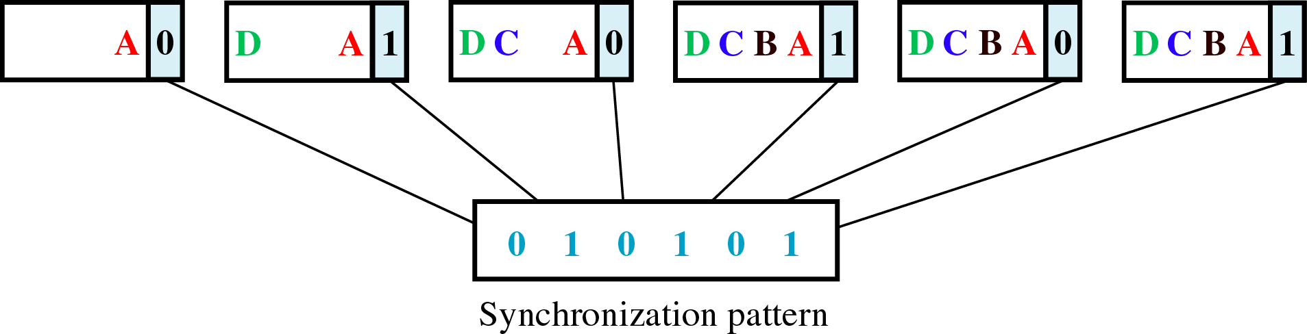
Synchronous TDM (cont’d)
Framing Synchronizing
  If the multiplexer and the demultiplexer are not synchronized, a bit belong to one channel may be received by the wrong channel.
  Framing bits allow the demultiplexer to synchronize with the incoming stream so that it can separate the time slots accurately.
  In most cases, this synchronization bits are added to the beginning of each frame, and synchronization information consists of 1 bit per frame, alternating between 0 and 1.(ex: 10101010 ….)
Fig 6.22

Slide 46
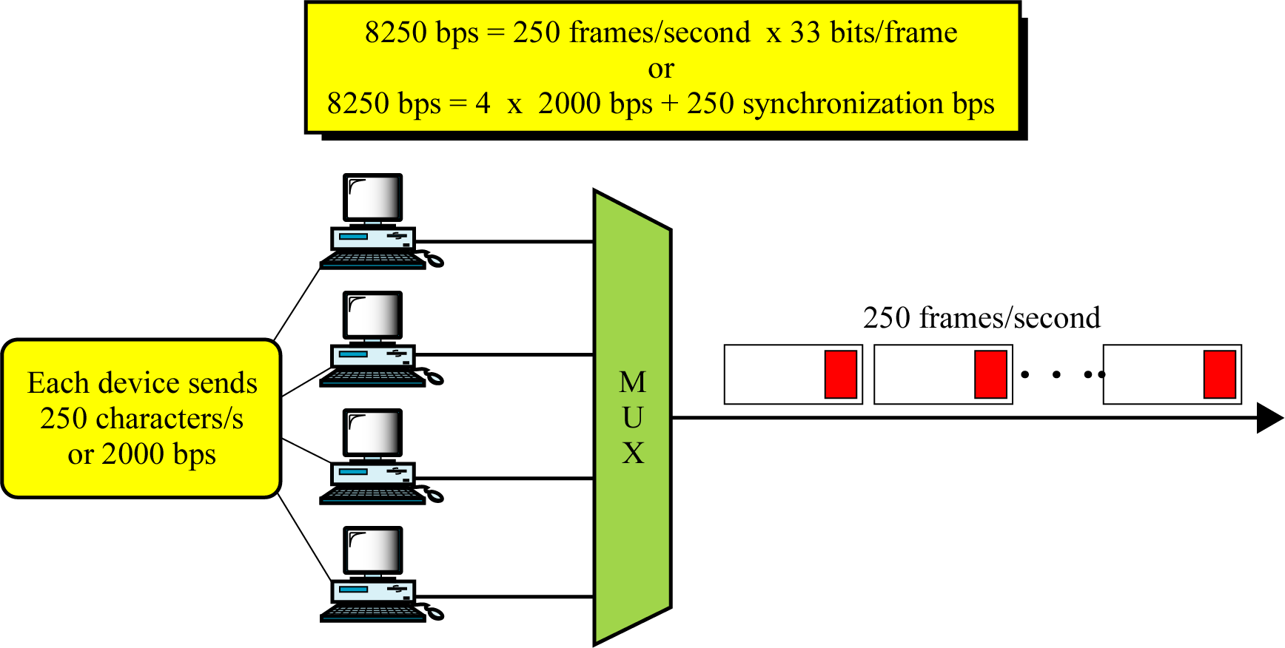
Synchronous TDM (cont’d)
Example6.10
Date rate of each source : 250 x 8 = 2000bps = 2kbps
Duration of a character: 1/250 sec or 4 ms
Frame rate: 250frames/sec
Duration of each frame: 1/250s or 4 ms
No. of bits per frame: 4 charaters + 1 extra sync bit = 33 bits
Date rate of link: 250 x 33 bits, or 8250
4 characters + 1 framing bit

Slide 47
Example 6.11
Two channels, one with a bit rate of 100 kbps and another with a bit rate of 200 kbps, are to be multiplexed. How this can be achieved? What is the frame rate? What is the frame duration? What is the bit rate of the link?
Solution
We can allocate one slot to the first channel and two slots to the second channel. Each frame carries 3 bits. The frame rate is 100,000 frames per second because it carries 1 bit from the first channel. Frame duration is 1/100,000s or 10μs. The bit rate is 100,000 frames/s × 3 bits per frame, or 300 kbps.

Slide 48

Digital Signal Service
DS(Digital Signal) Service
  - Digital Hierarchy
  advantage
    - less sensitive than analog service to noise
    - lower cost

Slide 49
Multiplexing application(cont’d)
DS Service
  DS-0 : single digital channel of 64Kbps
  DS-1 : 1,544Mbps, 24 x 64Kbps + 8Kbps (overhead)
  DS-2 : 6,312Mbps, 96 x 64Kbps+168Kbps (overhead)
  DS-3 : 44,376Mbps, 672 x 64Kbps+1.368Mbps (overhead)
  DS-4 : 274,176Mbps, 4032 x 64Kbps+16.128Mbps (overhead)

Slide 50

Multiplexing application(cont’d)
Table 6.1 DS and T line rates
376

Slide 51

Multiplexing application(cont’d)
T Lines for Analog Transmission
Figure 6.24 T-1 line for multiplexing telephone lines

Slide 52
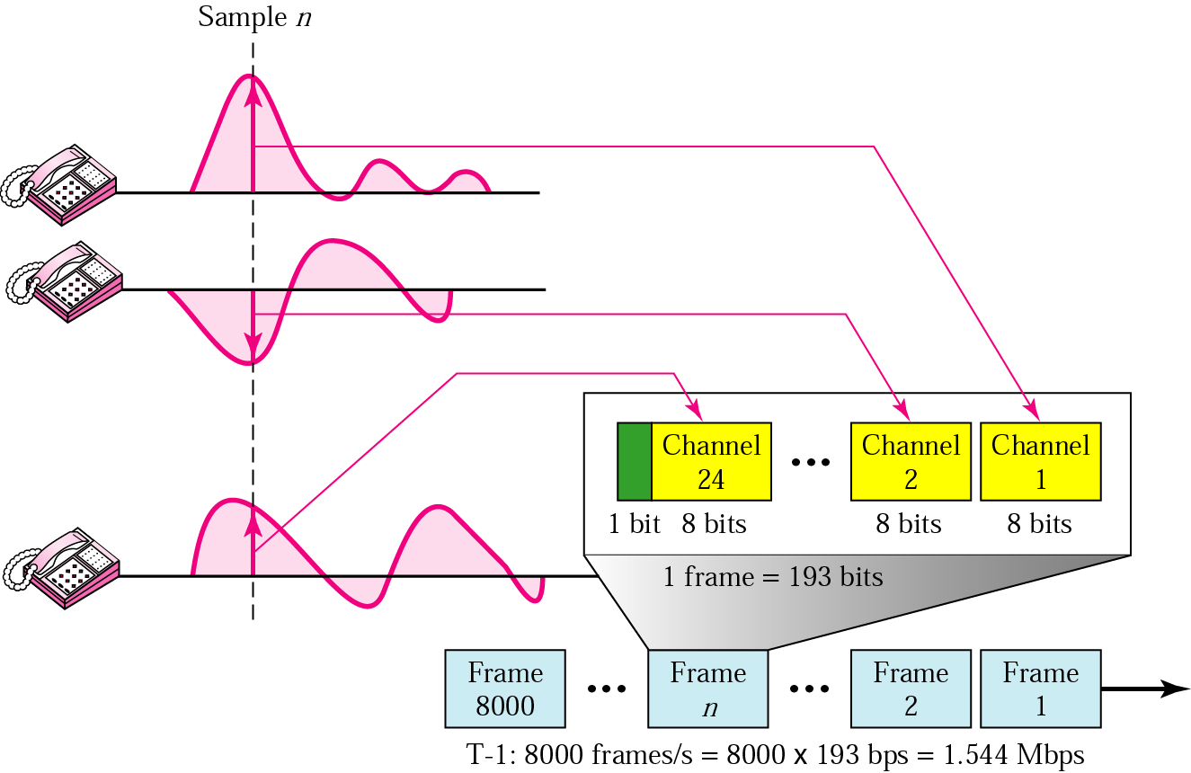
T-1 Frame structure
193 = 24 x 8 + 1(1 bit for synchronization)

Slide 53
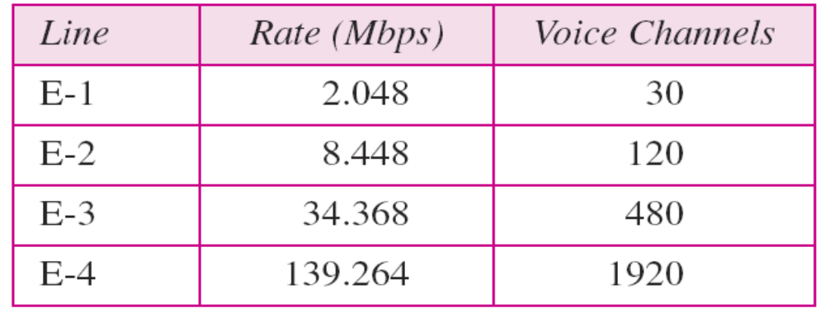
E Line
Table 6.2 E line rates

Slide 54
Statistical TDM
In statistical TDM, slots are dynamically allocated
to improve bandwidth efficiency.
In a synchronous TDM, some slots are empty
because the corresponding line does not have data
to send.
In statistical TDM, no slot is left empty as long as
there are data to be sent by any input line.

Slide 55

Statistical TDM
Figure 6.26 TDM slot comparison

Slide 56
Statistical TDM
Addressing
  A slot needs to carry data as well as the address of the destination.
  n-bits define N different output lines
    n = log₂ N
No synchronization bit
  The frame in the statistical TDM need not be synchronized, so we do not need synchronization bits.

Slide 57
6.2 SPREAD SPECTRUM
In spread spectrum (SS), we combine signals from different sources to fit into a larger bandwidth, but our goals are to prevent eavesdropping and jamming. To achieve these goals, spread spectrum techniques add redundancy.
Topics discussed in this section:
Frequency Hopping Spread Spectrum (FHSS)
Direct Sequence Spread Spectrum Synchronous (DSSS)

Slide 58

Spread Spectrum
Figure 6.27 Spread spectrum
Spread Spectrum achieves through two principles.
  The bandwidth allocated to each station needs to be larger
  than what is needed.
  The spreading process occurs after the signal is created
  by the source.

Slide 59

Spread Spectrum
Figure 6.28 Frequency hopping spread spectrum (FHSS)
FHSS uses M different carrier frequencies that are modulated by the source signal.
  At one moment, the signal modulates one carrier frequency;
  At the next moment, the signal modulates another carrier frequency.

Slide 60

Spread Spectrum
Figure 6.29 Frequency selection in FHSS

Slide 61

Spread Spectrum
Figure 6.30 FHSS cycles

Slide 62

Spread Spectrum
Figure 6.31 Bandwidth sharing
If the number of hopping frequencies is M, we can multiplex
M channels into one by using the same B_{ss} bandwidth.

Slide 63

Spread Spectrum
Figure 6.32 DSSS
In DSSS, we replace each data bit with n bits using a spreading code.
  Each bit is assigned a code of n bits, called chips, where the chip rate is n times that of the data bit.

Slide 64

Spread Spectrum
Figure 6.33 DSSS example

Slide 65
Summary (1)
Bandwidth utilization is the use of available bandwidth to achieve specific goals. Efficiency can be achieved by using multiplexing; privacy and antijamming can be achieved by using spreading
Multiplexing is the set of techniques that allows the simultaneous transmission of multiple signals across a single data link. In a multiplexed system, n lines share the bandwidth of one link. The word link refers to the physical path. The word channel refers to the portion of a link that carries a transmission.
There are three basic multiplexing techniques: frequency-division multiplexing, wavelength-division multiplexing, and time-division multiplexing. The first two are techniques designed for analog signals, the third, for digital signals
Wavelength-division multiplexing(WDM) is designed to use the high bandwidth capability of fiber-optic cable. WDM is an analog multiplexing technique to combine optical signals.

Slide 66
Summary (2)
Time-division multiplexing(TDM) is a digital process that allows several connections to share the high bandwidth of a link. TDM is a digital multiplexing technique for combining several low-rate channels into one high-rate one.
We can divide TDM into two different schemes: synchronous or statistical. In synchronous TDM, each input connection has an allotment in the output even if it is not sending data. In statistical TDM, slots are dynamically allocated to improve bandwidth efficiency.
In Spread spectrum(SS), we combine signals from different sources to fit into a larger bandwidth. Spread spectrum is designed to be used in wireless applications in which stations must be able to share the medium without interception by an eavesdropper and without being subject to jamming from a malicious intruder.

Slide 67
Summary (3)
The frequency hopping spread spectrum(FHSS) technique uses M different carrier frequencies that are modulated by the source signal. At one moment, the signal modulates one carrier frequency; at the next moment, the signal modulates another carrier frequency.
The direct sequence spread spectrum(DSSS) technique expands the bandwidth of a signal by replacing each data bit with n bits using a spreading code. In other words, each bit is assigned a code of n bits, called chips.

Slide 68

Q & A

